Slide 1
Effective Presentations EAL4650
Matt Potter
Producing Effective Visual Supporting Aids

Slide 2
Learning Outcomes
By the end of the class, you be able to:
Design slides that support complex academic arguments while maintaining clarity.
Evaluate the rhetorical function of visual aids (do they illustrate, persuade, or simplify?).
Present visual evidence orally with precision, using academic signal language and appropriate register.
Cite and contextualise visual data to demonstrate scholarly integrity.
Practise turning dense information into accessible, professional visuals.

Slide 3
major problems in Sub-Saharan African development.
Sub-Saharan Africa continues to face widespread poverty, with a significant proportion of the population living below the international poverty line of $2.15 per day (Mahler et al. (2021b).
Political instability and weak governance undermine sustainable development, often discouraging foreign investment and eroding public trust in institutions.
Many countries in the region experience persistent challenges in healthcare provision, including high maternal and child mortality rates and limited access to essential medicines.
Educational systems frequently suffer from underfunding, inadequate infrastructure, and teacher shortages, limiting opportunities for human capital development.
Rapid population growth places immense pressure on already strained resources such as food, water, and housing.
Climate change disproportionately affects Sub-Saharan Africa, leading to increased droughts, floods, and food insecurity across vulnerable communities.
Infrastructure deficits, particularly in energy, transport, and digital connectivity, constrain economic diversification and integration into global markets.
Corruption and mismanagement of natural resource revenues reduce the potential benefits of resource wealth and perpetuate inequality.
Armed conflict, terrorism, and intercommunal violence disrupt social cohesion, displace populations, and divert resources away from development priorities.
The region faces structural dependency on commodity exports, making economies vulnerable to external shocks and limiting industrialisation prospects.

Slide 4
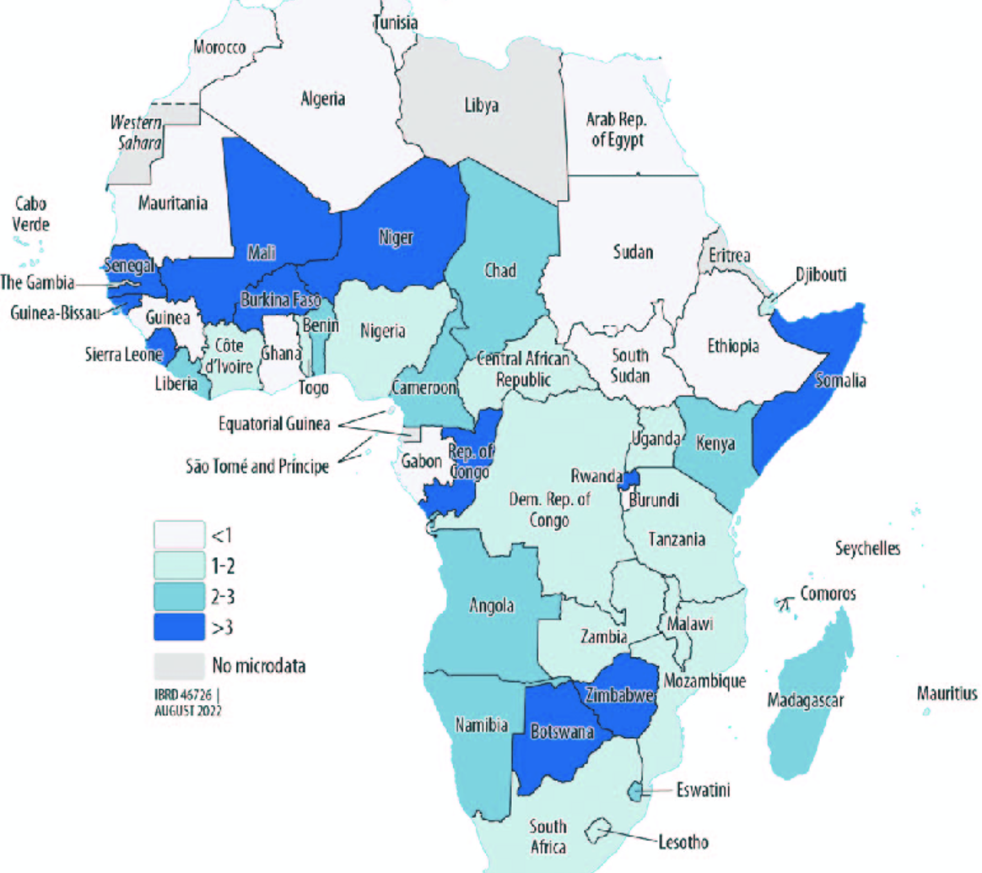
Development Challenges in Sub-Saharan Africa
High rural poverty & inequality
Limited infrastructure investment
Figure 1. Map of Extreme Poverty Changes in 2020 Due to COVID-19. Source: Mahler et al. (2021b).

Slide 5
Oral Delivery with Visuals – Academic Register
Slides = visual cues; speaker = interpretation.
Avoid simply reading slides aloud — audiences expect added value.
Balance spoken clarity with academic register:
  Informal: “This chart kinda shows…”
  Academic: “This chart illustrates the regional variation in…”
Maintain academic tone: avoid slang, fillers (“like,” “you know”).
Weak: “So yeah, this line goes up here.”
Intermediate: “The line shows a rise between 2000 and 2010.”
Strong: “This upward trajectory between 2000 and 2010 illustrates the acceleration of trade flows following China’s WTO accession, highlighting the intersection of institutional reform and global market integration.”

Slide 6
Signal language for presenting visuals:
Basic signal language:
“This slide illustrates…”
“As you can see from the diagram…”
“What this data suggests is…”
“In contrast to the previous chart…”
Advanced Functional Signal Language
Introducing: “Turning to this figure, we can observe…”
Highlighting: “The most striking trend here is the sharp decline in…”
Interpreting: “This suggests that economic liberalisation had a measurable effect.”
Linking: “Compared to the previous slide, this data reinforces the argument that…”

Slide 7
“I will structure my talk around three key themes: first…, second…, and finally…”
Recent research by Chen and Patel (2021) supports the argument that…”
“Imagine a situation where…”
“This map highlights the areas most affected by…”
“Notice how the data spikes at this point, indicating…”
Introducing Your Presentation
Referring to Visuals
Describing Graphic Data
Transitioning Between Slides
Emphasising Key Points
Comparing and Contrasting
Integrating Sources
Explaining Diagrams / Processes
Engaging the Audience
Summarising and Concluding
“This visual demonstrates the relationship between A and B.”
“While A suggests one conclusion, B seems to indicate…”
“Now let’s turn to another aspect of the problem…”
“This is a particularly significant finding because…”
“The evidence suggests that…”

Slide 8
Task
Choose a graphic relevant to the chosen topic of your presentation.
Design two slides:
Background and context
The relevant graphic (table, map, chart, diagram, etc.) with accompanying bullet points and oral commentary
Present to the group using appropriate signal language.
Feedback rubric
Slide readability (Poor–Good–Excellent)
Use of academic language (Informal–Appropriate–Sophisticated)
Oral delivery (Unclear–Clear–Engaging)

Slide 9
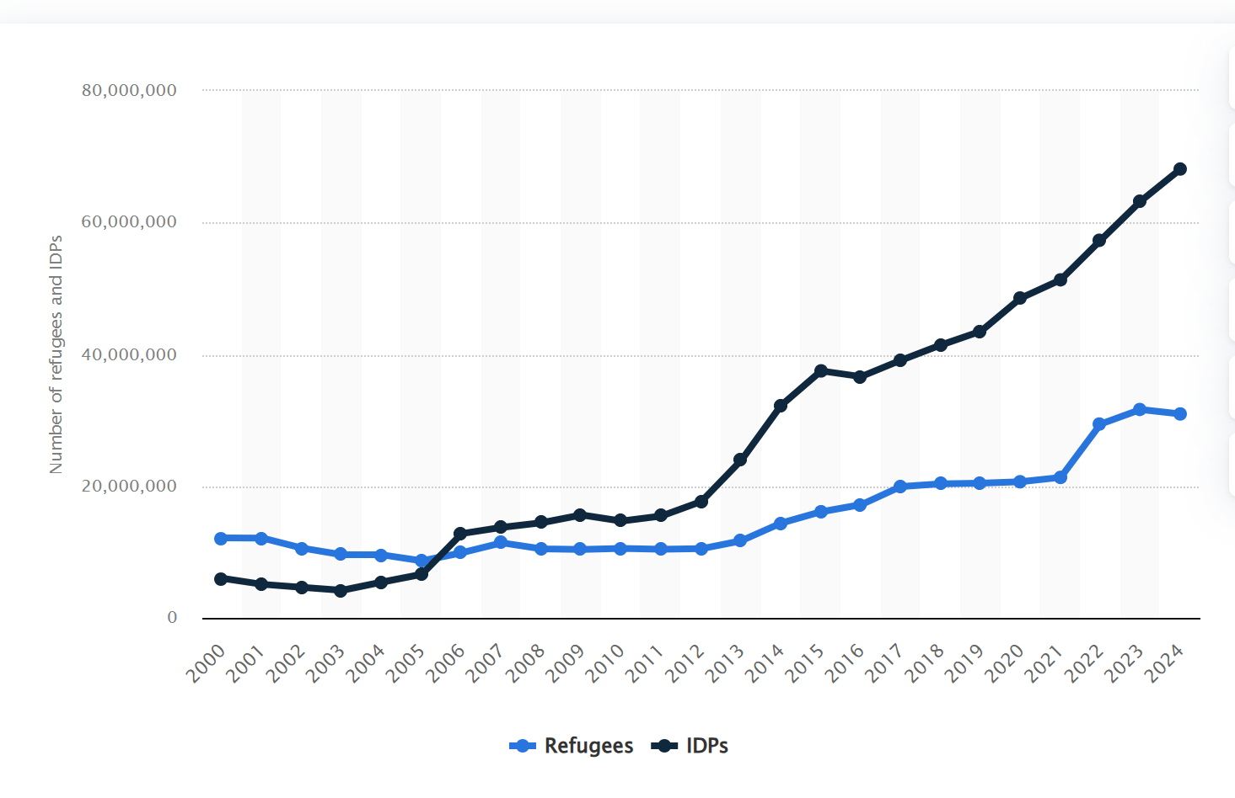
See QM+

Slide 10
Conclusion: Key Takeaways
Slides should clarify and amplify the spoken message, not duplicate it.
Effective visual aids balance simplicity with sophistication.
Academic register in oral delivery enhances credibility.
Visual data, when interpreted critically and cited properly, strengthens arguments.

